Slide 1
Formation and Adaptation of Reference Prices by Manitoban Grain Farmers: An Experimental Study
Jamie Poirier
Fabio Mattos
SPAA Network Annual Workshop – March 8, 2013

Slide 2
Outline
Introduction
Theoretical background
Hypotheses
Experiment
Results
Conclusions
Questions

Slide 3
Introduction
Motivation
Objective: to understand how Manitoban farmers form and adapt reference prices when marketing their grain
which market prices have greatest influence on the formation and adaptation of reference prices
how price expectations affect reference prices and decisions to sell
whether reference prices are adjusted differently for gains and losses
Importance

Slide 4
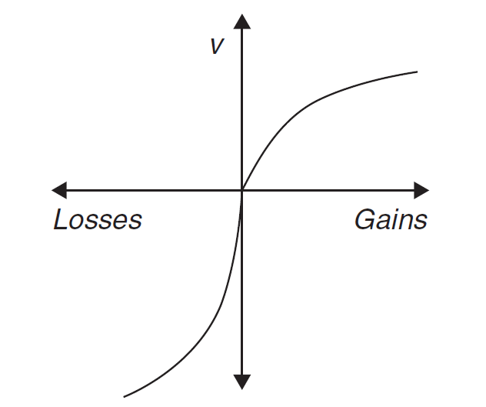
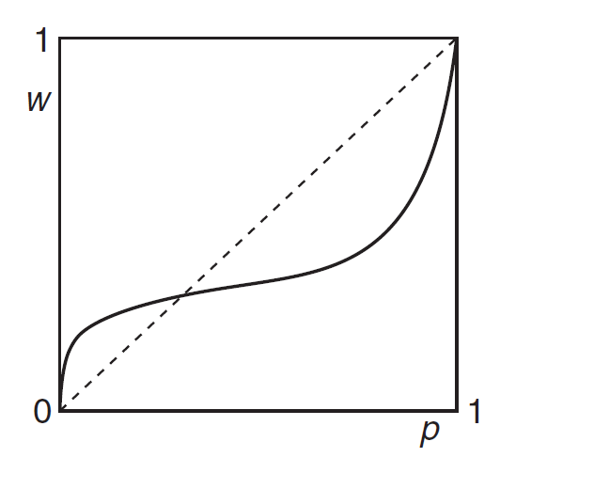
Theoretical Background
Prospect Theory
A descriptive model of decision making under risk
V(X) = ∑π(p_{i})v(x_{i})
Value function
Decision weighting function
Reference Prices
Formation
Adaptation

Slide 5
Reference Prices in Marketing Decisions
Farmer Forward Pricing Behavior: Evidence From Marketing Clubs.
McNew and Musser (2002)
A Marketing Approach to Commodity Futures Exchanges: A Case Study of the Dutch Hog Industry.
Meulenberg and Pennings (2002)
Producers’ Decision Making Process in Grain Marketing: A Study in the Canadian Market.
Fryza and Mattos (2011)
Notes:
McNew, Dutch Hogs, used last year’s price as status quo and expectation- predicted gain-sell, loss-hold. Found sell at lowest price. Current trend=price expectations
Meulenberg, reference price had predictive abilities for if farmers would hedge. RP heterogenity.
Fryza, Two of the explanatory variables in marketing decisions were past marketing performance and price signals.

Slide 6
Hypotheses
Reference Price Adaptation
Hypothesis 1
Incremental reference price adaptation follows market prices
Increasing incremental adaptation is larger than decreasing incremental adaptation
Hypothesis 2
Total reference price adaptation follows market prices
Increasing total adaptation is larger than decreasing total adaptation
Hypothesis 3
Adaptation becomes larger over time
Increasing adaptation over time is larger than decreasing adaptation over time

Slide 7
Hypotheses
Effects of Reference Prices on Decisions to Sell
Hypothesis 4
selling increases as price expectations decrease
selling increases as the reference price decreases relative to the current price

Slide 8
Research Method
Survey/experiment: 75 grain farmers in Manitoba
July-August 2012
Survey: demographic information
such as farm location, age, education, experience, farm size, break-even price, self-reported risk preference
Elicitation of risk preferences
certainty equivalent

Slide 9
Research Method
Dynamic experiment simulating marketing decisions of Manitoban grain farmers over 10 months
In the next period, what is the price of wheat which would make you feel satisfied if you were to sell the rest of your wheat?
In the next period, if the price of wheat increases, what is the price you would sell the remainder of your wheat at?
How do you expect the price of wheat will change over the next month? Please enter the probability of each scenario in the space provided.
I expect the price will increase ( %)
I expect the price will remain about the same ( %)
I expect the price will decrease ( %)
Do you want to hold all, sell all or sell some wheat now?

Slide 10
Research Method
Dynamic experiment simulating marketing decisions of Manitoban grain farmers over 10 months
In the next period, what is the price of wheat which would make you feel satisfied if you were to sell the rest of your wheat?
In the next period, if the price of wheat increases, what is the price you would sell the remainder of your wheat at?
How do you expect the price of wheat will change over the next month? Please enter the probability of each scenario in the space provided.
I expect the price will increase ( %)
I expect the price will remain about the same ( %)
I expect the price will decrease ( %)
Do you want to hold all, sell all or sell some wheat now?

Slide 11
Research Method
Dynamic experiment simulating marketing decisions of Manitoban grain farmers over 10 months
In the next period, what is the price of wheat which would make you feel satisfied if you were to sell the rest of your wheat?
In the next period, if the price of wheat increases, what is the price you would sell the remainder of your wheat at?
How do you expect the price of wheat will change over the next month? Please enter the probability of each scenario in the space provided.
I expect the price will increase ( %)
I expect the price will remain about the same ( %)
I expect the price will decrease ( %)
Do you want to hold all, sell all or sell some wheat now?

Slide 12
Research Method
Dynamic experiment simulating marketing decisions of Manitoban grain farmers over 10 months
In the next period, what is the price of wheat which would make you feel satisfied if you were to sell the rest of your wheat?
In the next period, if the price of wheat increases, what is the price you would sell the remainder of your wheat at?
How do you expect the price of wheat will change over the next month? Please enter the probability of each scenario in the space provided.
I expect the price will increase ( %)
I expect the price will remain about the same ( %)
I expect the price will decrease ( %)
Do you want to hold all, sell all or sell some wheat now?

Slide 13
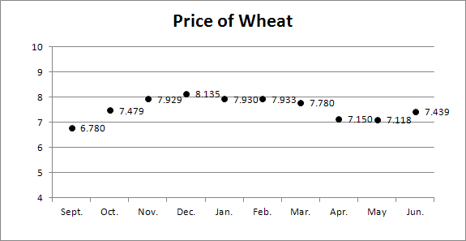
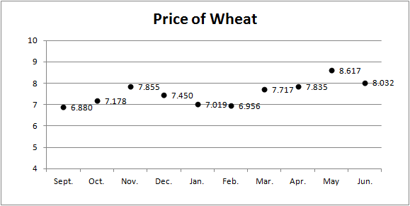
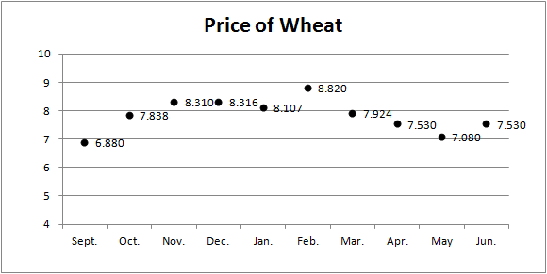
Increasing Price Sequences

Slide 14
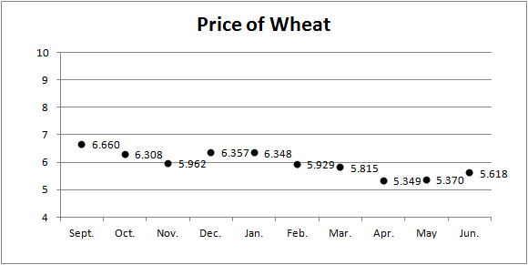
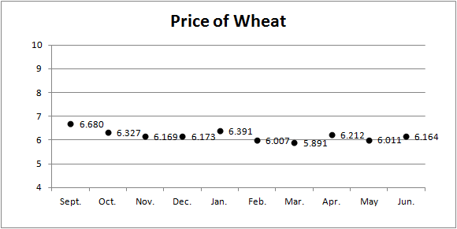
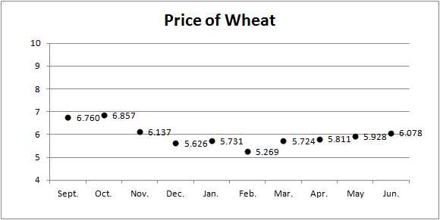
Decreasing Price Sequences

Slide 15
Farmer Locations

Slide 16
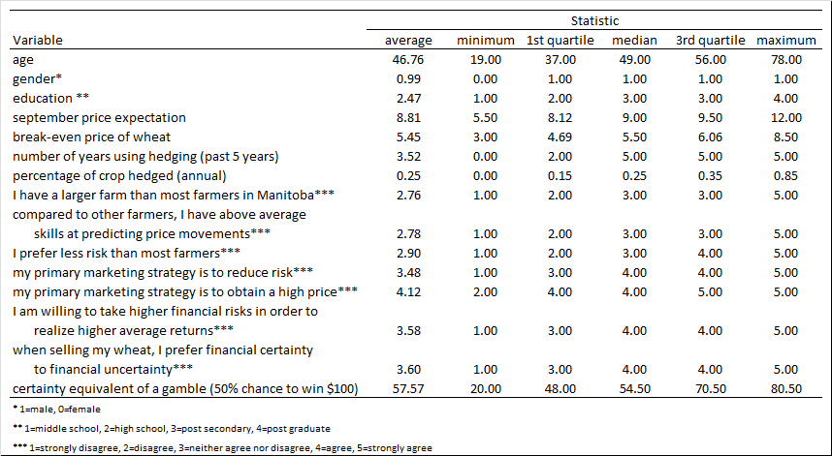
Survey: descriptive statistics
Notes:
Panel Data
Fixed Effects

Slide 17
Survey: descriptive statistics
Notes:
Panel Data
Fixed Effects

Slide 18
Survey: descriptive statistics
Notes:
Panel Data
Fixed Effects

Slide 19
Survey: descriptive statistics
Notes:
Panel Data
Fixed Effects

Slide 21
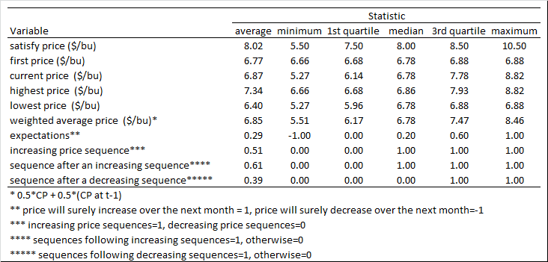
Experiment: results – 1
Model: Formation of Satisfy Prices
Descriptive statistics

Slide 22
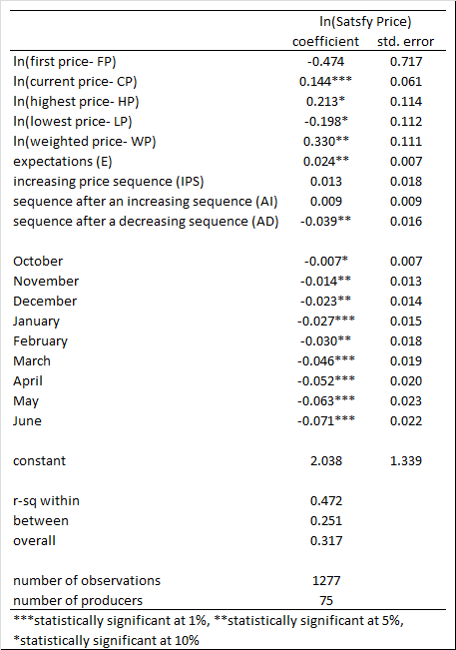
Estimated Panel Regression
Dependent variable: satisfy price
Explanatory variables:
first price
current price
highest price to date
lowest price to date
average price to date
price expectation
control variables

Slide 23
Estimated Panel Regression
Dependent variable: satisfy price
Explanatory variables:
first price
current price
highest price to date
lowest price to date
average price to date
price expectation
control variables

Slide 24
Estimated Panel Regression
Dependent variable: satisfy price
Explanatory variables:
first price
current price
highest price to date
lowest price to date
average price to date
price expectation
control variables

Slide 25
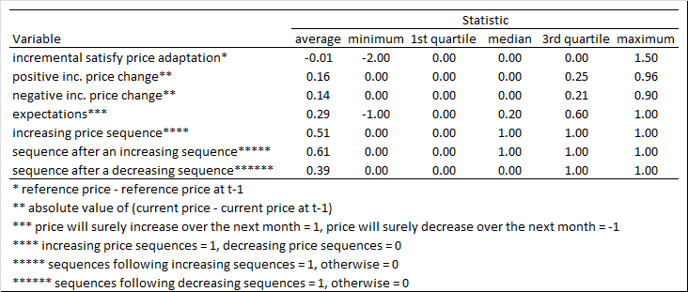
Experiment: results – 2
Model: Incremental Satisfy Price Adaptation
IA_{it} = α + β₁ΔIP(p)_{it} + β₂|ΔIP(n)|_{it} +β₃E_{it} + β₄IPS_{it} + β₅AI_{it} + β₆AD_{it} + ε_{it}
Descriptive statistics

Slide 26
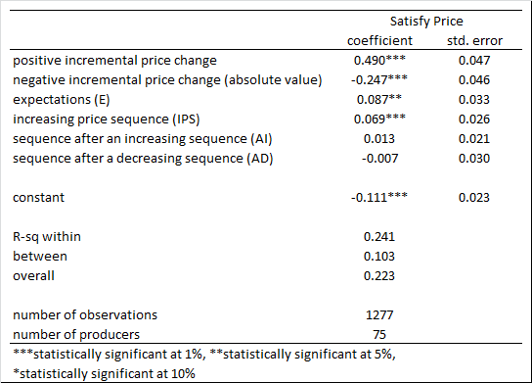
Estimated Panel Regression
Dependent variable: monthly change in satisfy price
Explanatory variables:
monthly change in market price (positive)
monthly change in market price (negative)
price expectation
control variables

Slide 27
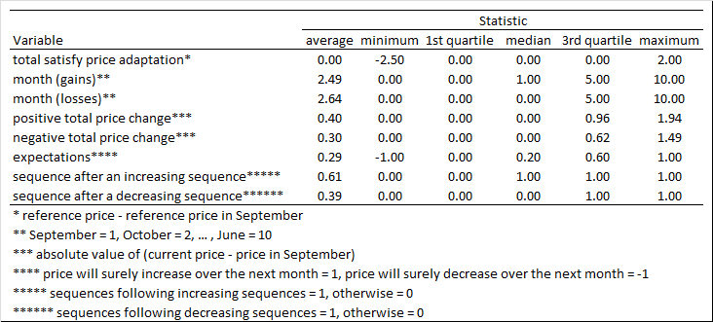
Experiment: results – 3
Model: Total Satisfy Price Adaptation
TA_{it} = α + β₁Month(i)_{it} + β₂Month(d)_{it} + β₃ ΔTP(p)_{it} + β₄ΔTP(n)_{it} + β₅E_{it} + β₆AI_{it} + β₇AD_{it} + ε_{it}
Descriptive statistics

Slide 28
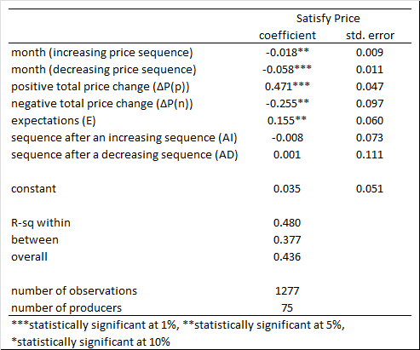
Estimated Panel Regression
Dependent variable: total change to-date in satisfy price
Explanatory variables:
total change to-date in market price (positive)
total change to-date in market price (negative)
price expectation
control variables

Slide 29
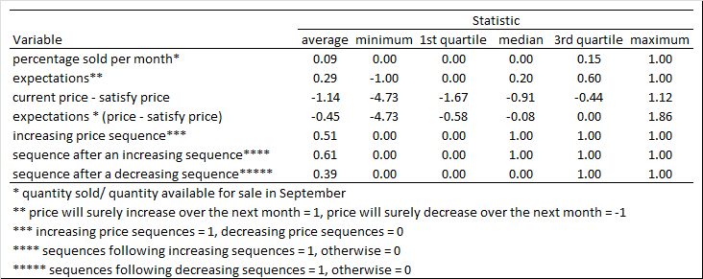
Experiment: results – 4
Model: Selling Decisions
%S_{it} = α + β₁E + β₂(CP_{it} – SP_{it}) + β₃(E_{it})(CP_{it} – SP_{it}) + Β₄IPS_{it} + β₅AI_{it} + β₆AD_{it} + ∑_{j=1}⁹θ_{ij}M_{ij} + ε_{it}
Descriptive statistics

Slide 30
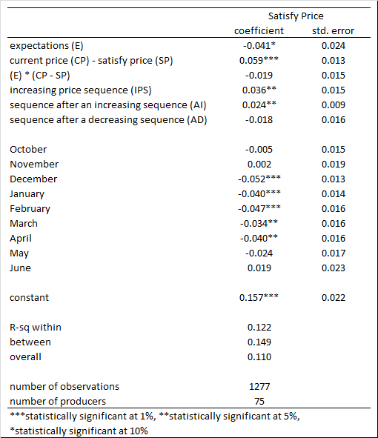
Estimated Panel Regression
Dependent variable: proportion of crop sold on month t
Explanatory variables:
price expectation
spread between current market price and satisfy price
control variables

Slide 31
Conclusions
Reference Price Formation
Weighted average and highest price
Incremental Reference Price Adaptation
positive > negative
Total Reference Price Adaptation
positive > negative
Selling Decisions
> ‘loss’ = < selling

Slide 32
Conclusions Con’t
Implications
Limitations
Future work

Slide 33
Questions?
Jamie Poirier
jamie.k.poirier@gmail.com
Fabio Mattos
fmattos@unl.edu

